Slide 1
Altai State University
White House
MADE BY : besedovskiy vasiliy
GROUP: k105c11-5

Slide 2
Plan
What is the White House?
About the white house.
Layout and amenities
Building history.
Creation of the name of the white house
West Wing
East Wing

Slide 3
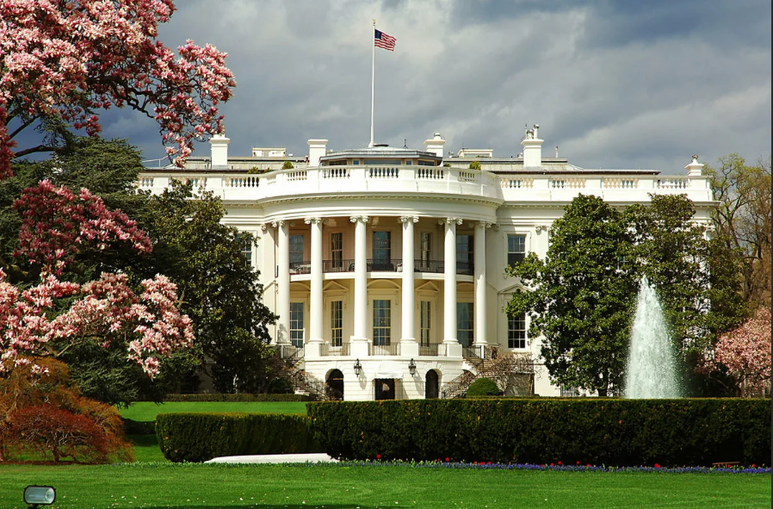
What is the White House?
The White House is the official office and residence of the president of the United States. It is located at 1600 Pennsylvania Avenue N.W. in Washington, D.C.

Slide 4
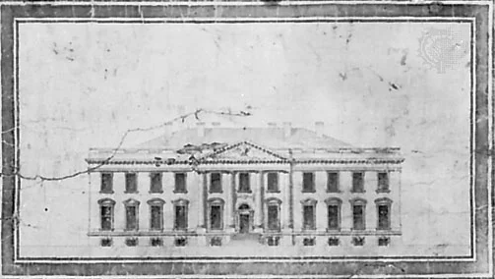
About the white house
White House, formerly (1810–1901) Executive Mansion, the official office and residence of the president of the United States at 1600 Pennsylvania Avenue N.W. in Washington ,DC. It is perhaps the most famous and easily recognizable house in the world, serving as both the home and workplace of the president and the headquarters of the president’s principal staff members.
Originally called the “President’s Palace” on early maps, the building was officially named the Executive Mansion in 1810 in order to avoid connotations of royalty. Although the name “White House” was commonly used from about the same time (because the mansion’s white-gray sandstone contrasted strikingly with the red brick of nearby buildings), it did not become the official name of the building until 1901, when it was adopted by Pres.
White House, drawing by James Hoban

Slide 5
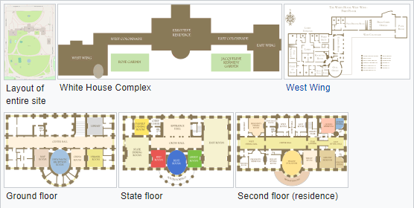
Layout and amenities
Today the group of buildings housing the presidency is known as the White House Complex. It includes the central Executive Residence flanked by the East Wing and . The Chief Usher coordinates day to day household operations. The White House includes six stories and 55,000 square feet (5,100 m²) of floor space, 132 rooms and 35 bathrooms, 412 doors, 147 windows, twenty-eight fireplaces, eight staircases, three elevators, five full-time chefs, a tennis court, a (single-lane) bowling alley, a movie theater (officially called the White House Family Theater, a jogging track, a swimming pool, and a putting green. It receives up to 30,000 visitors each week.

Slide 6
Building history
The building’s history begins in 1792, when a public competition was held to choose a design for a presidential residence in the new capital city of Washington.
The structure was to have three floors and more than 100 rooms and would be built in sandstone imported from quarries along Aquia Creek in Virginia.
The cornerstone was laid on October 13, 1792. Labourers, including local enslaved people, were housed in temporary huts built on the north side of the premises. They were joined by skilled stonemasons from Edinburgh, Scotland.

Slide 7
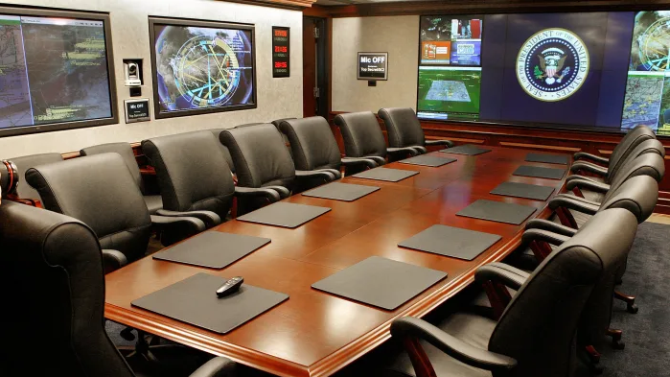
Creation of the name of the white house
The stone exterior of the building was first painted with a lime-based whitewash in 1798 to protect it from the elements and freezing temperatures. According to the White House Historical Association, the "White House" moniker began to appear in newspapers before the War of 1812.
But it was President Theodore Roosevelt, who, in 1901, designated the official name of the residence of the U.S. president to be the White House. (Previous names included the Presidents' House, the Executive Mansion, the Presidential Palace and the Presidential Mansion.) It also commonly goes by “The People’s House.”
The main conference area of the White House Situation Room.

Slide 8
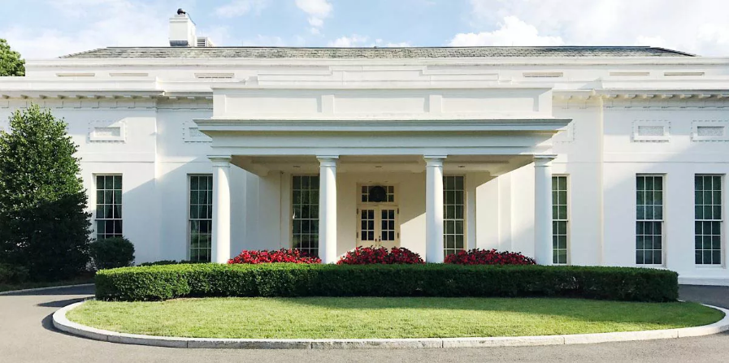
West Wing
The West Wing houses the president's office (the Oval Office) and offices of his senior staff, with room for about 50 employees. It also includes the Cabinet Room, where the president conducts business meetings and where the Cabinet meets, as well as the , James S. Brady Press Briefing Room, and Roosevelt Room cables and LCD screens for the display of charts and graphs. The makeover took 11 months and cost of $8 million, out of which news outlets paid $2 million. In September 2010, a two-year project began on the West Wing, creating a multistory underground structure. Some members of the president's staff are located in the adjacent Eisenhower Executive Office Building, which was, until 1999, called the Old Executive Office Building and was historically the State War and Navy building. The Oval Office, Roosevelt Room, and other portions of the West Wing were partially replicated on a sound stage and used as the setting for The West Wing".

Slide 9
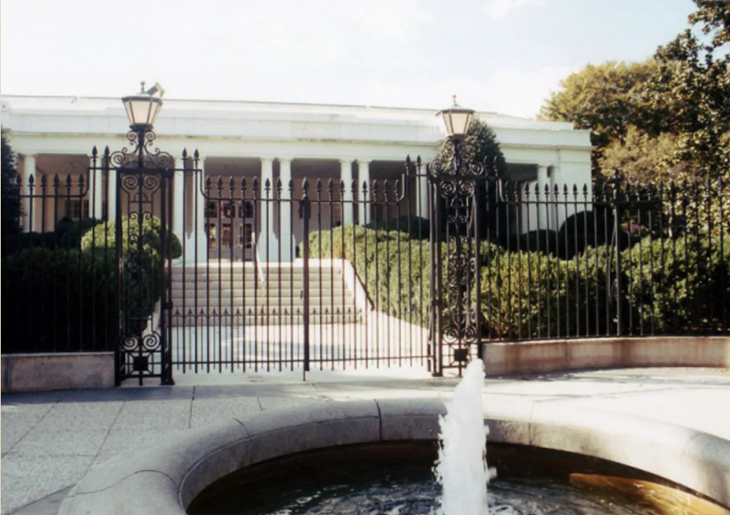
East Wing
The East Wing, which contains additional office space, was added to the White House in 1942. Among its uses, the East Wing has intermittently housed the offices and staff of the first lady and the White House Social Office. Rosalynn Carter, in 1977, was the first to place her personal office in the East Wing and to formally call it the "Office of the First Lady". The East Wing was built during World War II in order to hide the construction of an underground bunker to be used in emergencies. The bunker has come to be known as the Presidential Emergency Operations Center.

Slide 10
The End
Thank you for attention

